Slide 1
STRAT_EDGE · ASAAS FEST · DEPT. OF BUSINESS ADMINISTRATION, AMU
The $50 Million Question:
$50M
Can XYZ Healthcare Make AI Pay?
AI Value Recovery Plan for XYZ Healthcare Leadership
Team: The Barkaat Trio
Competition: STRAT_EDGE Case Competition
Date: 23 April 2026
Sources: McKinsey & Company | Grand View Research | Becker's Hospital Review | Strativera | Emorphis Health

Slide 2
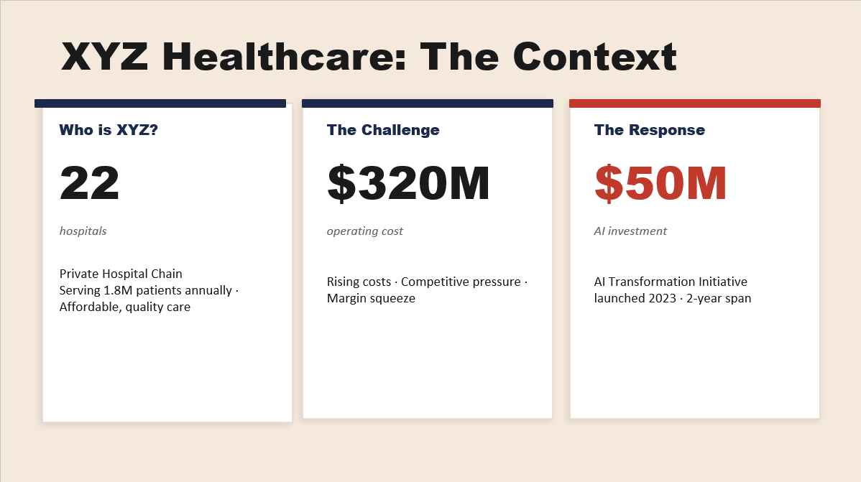

Slide 3
01
Diagnostic: XYZ Has a $25M Value Gap — Not a Tech Problem
AI adoption is widespread — but 94.5% of organizations, including XYZ, fail to see meaningful financial returns (McKinsey, March 2025)
AI Investment
Value Captured
Current ROI
Staff Trust AI
$50M
$25M
0.5×
38%
2-year total
$15M savings + $10M revenue
vs. 3.2× industry benchmark
57% fear job loss
ROOT CAUSE: STRUCTURAL FAILURES
EMPLOYEE SENTIMENT SURVEY (2025)
①
EHR Silo Problem
AI improves my productivity
62%
AI runs outside Electronic Health Records — forcing platform switches, killing usage
I trust AI recommendations
38%
②
No Clinical Co-Design
AI threatens my job security
IT/Admin deployed clinical AI without senior clinician involvement
57%
③
Training Deficit
⚠ IBM Watson Health: A $5B Lesson
Only a 2-day one-time session — 59% still feel undertrained
Watson failed not due to weak AI, but due to:
• No EHR integration • Low clinician trust • No clear ROI
XYZ is showing all three warning signs. Act now.
④
No Strategic Focus
AI deployed everywhere at once; no prioritization of high-ROI use cases
Sources: McKinsey State of AI (March 2025, n=1,993) | XYZ Internal Survey (2025) | Healthcare Dive (Oct 2025)

Slide 4
02
Strategic Prioritization: The AI Value Leakage Model
Stop deploying more AI — Start recovering value from the AI you already own
LEAKAGE 01
LEAKAGE 02
LEAKAGE 03
Integration Failure
Adoption Collapse
Wrong Prioritization
AI tools not embedded in EHR — clinicians must switch platforms. Epic-bundled AI achieves 90% adoption vs. 50% for standalone tools.
Only 38% trust AI. High override rates waste the $50M investment. One-time 2-day training is insufficient for culture change.
Budget spread across all AI simultaneously. No focus on high-ROI use cases. Admin AI has fastest payback (12–18 months).
✓ Fix: Deep EHR Integration
✓ Fix: AI Academy (CommonSpirit model)
✓ Fix: Focus on Top 2 Revenue Levers
AI USE CASE PRIORITIZATION MATRIX
AI Use Case | Priority | Payback Period | Incremental Value (Yr 1) | Action
Admin AI: RCM / Billing & Coding | 🔥 HIGHEST | 12–18 months | $5M – $8M | Integrate NOW
Operational: Bed Management & Readmission | 🔥 HIGH | 12–18 months | $3M – $5M | Scale Fast
Clinical: Radiology / Pathology AI | MEDIUM | 24–36 months | $2M – $3M | EHR-integrate first
Chatbots & Predictive Disease Models | DEFER | 36+ months | Unclear | Hold spending
Sources: McKinsey State of AI (Mar 2025) | HealthIT.gov (2024) | Strativera (2025) | Emorphis Health (2026) | Axis Intelligence (2025)

Slide 5
03
Financial Impact: Path from 0.5× to 3.2× ROI
Fixing EHR integration + launching AI Academy can unlock $25M–$38M in additional annual value by Year 3
ROI GAP ANALYSIS
3-YEAR VALUE UNLOCK PROJECTION
XYZ is operating at just 0.5× ROI — 6× below industry high-performer benchmark of 3.2× (Strativera, 2025)
Initiative | Year 1 | Year 3 (Annual) | Benchmark Source
Admin AI (RCM + Billing) | $5–8M | $12–18M/yr | Axis Intel / Strativera 2025
Bed Mgmt & Readmissions | $3–5M | $8–12M/yr | Johns Hopkins / PMC 2025
Clinical AI (EHR-integrated) | $2–3M | $5–8M/yr | arXiv 2025 / Signity 2025
TOTAL VALUE UNLOCK | $10–16M | $25–38M/yr | Payback by Yr 2.5
Metric | 2023 (Pre-AI) | 2025 (Post-AI)
Operating Cost | $320M | $305M ↓
Revenue | $400M | $410M ↑
Bed Utilization | 68% | 74% ↑
Wait Time | 45 min | 35 min ↓
💡 Each avoided readmission saves ~$15,200 | Bed utilization → 85% unlocks ~$25–30M in revenue
Sources: Strativera (Oct 2025) | Axis Intelligence (Jun 2025) | PMC 2025 | arXiv 2025 | Johns Hopkins study (Axis 2025)

Slide 6
04
Implementation Roadmap & Change Management
From Deployment to Value: 3-Phase AI Value Recovery Plan
STABILIZE
SCALE VALUE
OPTIMIZE
PHASE 1
PHASE 2
PHASE 3
0 – 3 Months
3 – 9 Months
9 – 18 Months
Launch Clinical Council: Senior doctors lead AI re-design
Launch AI Academy (9 courses, 16 micro-modules — CommonSpirit model)
Clinical AI (Radiology / Sepsis detection): fully EHR-embedded
Shadow Clinician Program: IT developers observe real-world workflows
Full RCM + Billing AI integration → Target $5–8M savings
Shift governance from IT to AI Centre of Excellence (CoE)
EHR Integration Sprint: Remove platform-switching for top 2 AI tools
Bed Management AI: Push utilization from 74% → 82% (→ ~$15M revenue)
ABDM Integration: Link 1.8M patient data to India's 799M health IDs
Internal Rebrand: Position AI as 'Clinical Co-Pilot', not replacement
Performance incentives tied to AI adoption KPIs per department
Outcome metrics shift: from wait times → EBITDA margin per procedure
KPI: Override rate ↓ 20% in 90 days
KPI: ROI improves from 0.5× → 1.5×
KPI: Target 3.2× ROI benchmark by Month 18
CHANGE MANAGEMENT: THE TRUST EQUATION
Explainable AI
Retention ROI
ABDM Advantage
IBM Watson Lesson
Move from 'black box' to transparent recommendations — clinicians need the WHY, not just WHAT
Replacing 1 physician costs 2–3× salary. AI reduces 'pajama time' 60% (Univ. Vermont trial)
Link XYZ's 1.8M patients to India's 799M digital health IDs — unmatched predictive data moat
Watson's $5B failure = no EHR integration + no trust. XYZ's plan directly addresses both
Sources: CommonSpirit AI Academy (Becker's, Jan 2026) | University of Vermont AI Scribe Study | PIB India (Feb 2026) | NCBI JAMIA (May 2025) | Healthcare Dive (Oct 2025)

Slide 7
Our Recommendation
XYZ doesn't have an AI problem.
It has an adoption + integration problem.
3.2×
$38M
18mo
Target ROI
Yr 3 Annual Value
Full Payback
vs. current 0.5×
unlocked with plan
on $50M investment
Shift AI from a Cost Center → to a Profit Engine
Thank You — We Welcome Your Questions
Department of Business Administration · FMSR · Aligarh Muslim University · STRAT_EDGE | ASAAS Fest 2026
All financial projections are conservative estimates based on benchmarked industry outcomes (Strativera 2025, Axis Intelligence 2025, McKinsey 2025). Actual results depend on execution quality and depth of change management.

